Slide 1

Francois Brouet – sep24_continuous_ds

Slide 2
Subject, problem, issues
Data (volume, architecture)
identification long.mode, MAC
(streamlit) dataframes
Data visualization
(streamlit) distribution of the expl. variables
(streamlit) identified long. mode
Pre-processing
slot classes
NRDD
Long .frequencies
(streamlit) Trained models and results, tuned model
(streamlit) Best & worst predictions
(streamlit) Filtered data
Link results with the business issue, Next Steps
Conclusion & Outlook
20 min presentation
10 min questions
2

Slide 3
Introduction
01

Slide 4
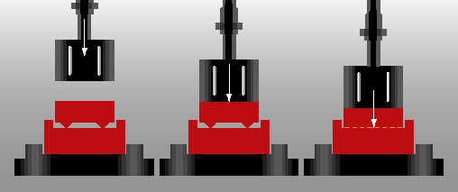
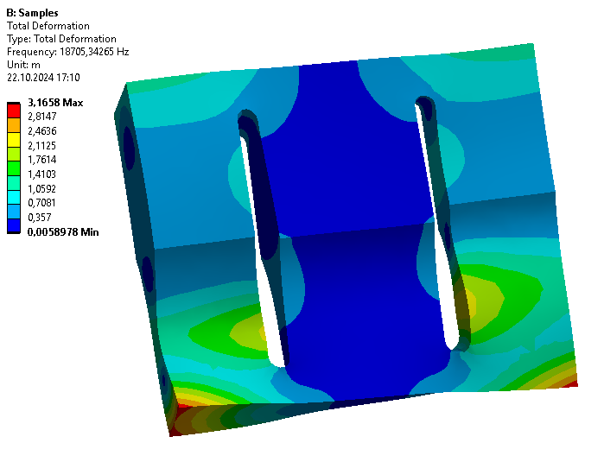
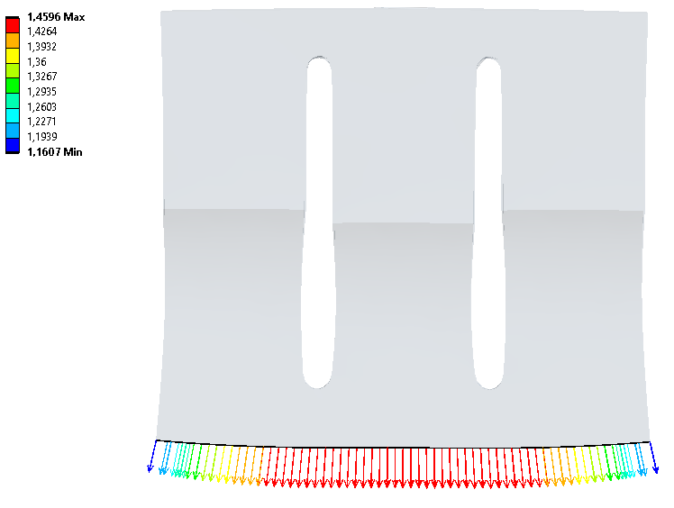
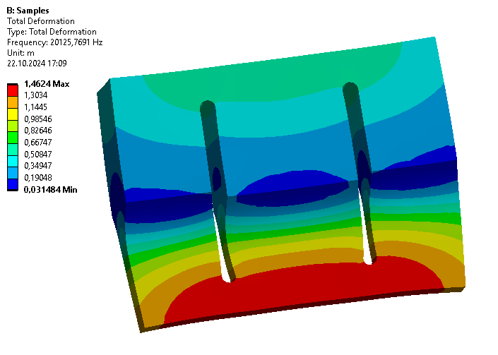
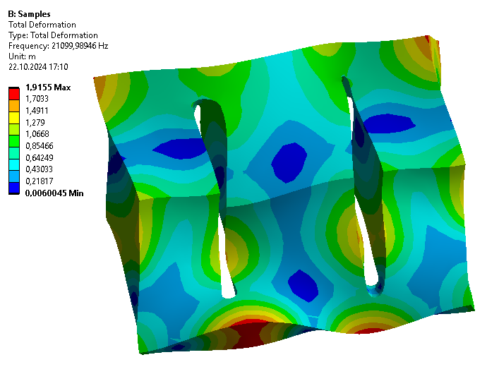
Context
Concept of the ultrasonic welding:
convert the vibration energy to the welding parts
energy transformed in heat by friction
with mechanical force → new connection
Ultrasonic sonotrode
longitudinal mode used to drive the vibration
must meet requirements:
frequency ~ 20 kHz
longitudinal mode isolated
uniform displacements at the output
Notes:
US-Welding
Mechanical vibrations transfer the kinetic energy into a part
This energy is transformed in heat by the surface friction
The material starts to melt
The material is compressed by a mechaniical force (parallel to melting)
A new homogeneous connection is created
Sonotrode:
is in contact with the welding part
has many vibrating modes (each mode has a eigenfrequency and a eigenshape)
longitudinal mode is used
Simulation with FEM software (ANSYS)
Requirements
Longitudinal mode‘s frequency should be close to 20 kHz (driving frequency)
Longitudinal mode should be isolated from other modes
Longitudinal mode‘s displacements should be as uniform as possible over the welding surface

Slide 5
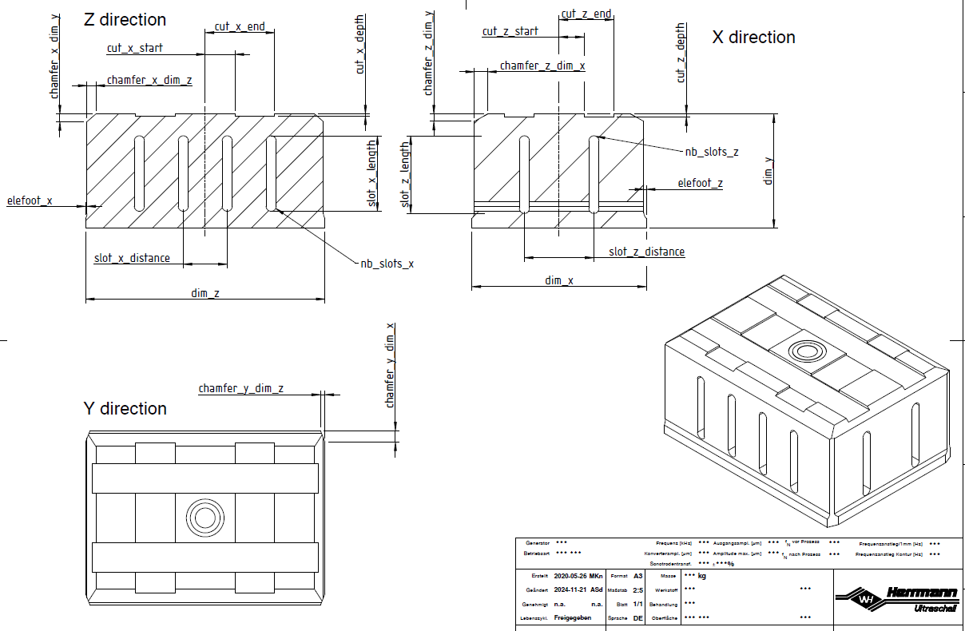
Goal
Main goal: Prediction of the FEM results from the sonotrode geometry
3 predictions:
longitudinal frequency
frequencies of all modes
uniformity of the output displacements
Geometry: 23 parameters
(dim_x) × (dim_z): output surface
(dim_y): length
…
Notes:
Goal of this project was to predict the results of FEM simulations (modal properties) without running them
Simulations of complex geometries are computer-intensive → one iteration can take up to an hour
FEM results splitted in 3 subgoals (different target variables)
- Prediction of the longitudinal mode’s frequency (or “long. frequency”)
- Prediction of the frequency of all other modes: Focus near the longitudinal mode (ex: 5 modes below and 5 modes above).
- Prediction of the uniformity of the displacements (as a number), instead of all displacement values
Each subgoal:
visualization
parameter influences
modeling
result interpretation
Geometry described by 23 parameters
dim_x / dim_z welding (output) surface, usually fixed by the welding part
dim_y: oscillation length, important feature to tune the longitudinal frequency
here: 4 slots and 2 slots in both directions
other dimensions: free, used to optimize the modal properties

Slide 6
Data
MAC (Modal Assurance Criterion)
comparison of the mode shapes with a reference longitudinal mode shape
0 = no correspondance
1 = full correspondance
Identification of the longitudinal mode
mode with the lowest MAC value
8000 design points (DP) = geometries
CSV files
Data set (Streamlit)
DataFrames: parameters / modes / nodes / defs
Notes:
Before we take a look on the dataset, I present right away 2 important notions:
the MAC value is an indicator, comparing the calculated mode shapes with a reference shape, chosen as an ideal long. mode shape
The mode shapes are vectors of displacements (for a matter of simplicity, we take only the displacements of the nodes located at the input and output surfaces)
the MAC value is bounded between 0 (no correspondance with the long. mode shape) and 1 (equals the longitudinal mode shape)
the MAC value is directly calculated in the FEM program when the simulation is complete
When the simulation is complete and´all modes are calculated, the long. mode is found by comparing the MAC value of every modes.
The mode with the highest value is marked as the long. mode. The mode number can change between 2 geometries.
A design point represents a unique geometry as a 23-dimensional vector. Before the start of the project, the DP are randomly picked inside a parameter space, that I defined to keep a valid sonotrode geometry.
There are about 8000 DP. The data was stored in CSV files written by the FEM program ANSYS.
During the step of data collection, I imported the 24,000 CSV files into 4 dataframes, that we will see in streamlit

Slide 7
(Streamlit)
Notes:
4 dataframes
parameters
modes
nodes
defs

Slide 8
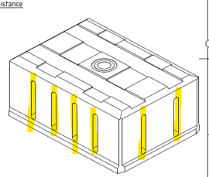
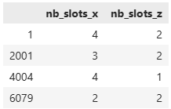
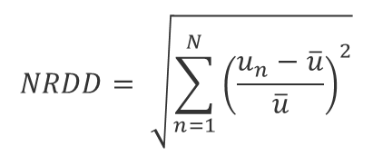
Pre-processing
Slot classes
NRDD
Norm of the Relative Displacement Deviation
width (x)
depth (z)
$$NRDD= \sqrt{\sum_{n=1}^{N}{{\left(\frac{u_{n}−\overline{u}}{\overline{u}}\right)}^{2}}}$$
un: displacement of the node n
u: average of all displacements
N: number of nodes (output surface)
Notes:
I added new features to the dataset
The sonotrode needs slots in both directions for acoustical reasons and the number of slots is variable. During the generation of the design points, I used 4 combinations of slot distributions.
The width (highest dimension) needs more slots than the depth.
The numbers of slots in both directions are categorical and forming a class with 4 values
The prediction of the output displacements themselves was not successful. Since the 3rd goal is to predict only the uniformity, I introduced a new metric to evaluate the uniformity of the displacements.
The Norm of the Relative Displacement Deviation (called NRDD) is obtained:
by taking the relative difference of the displacements to the average
the deviations are squared and summed up for all nodes
the root value gives the NRDD value

Slide 9
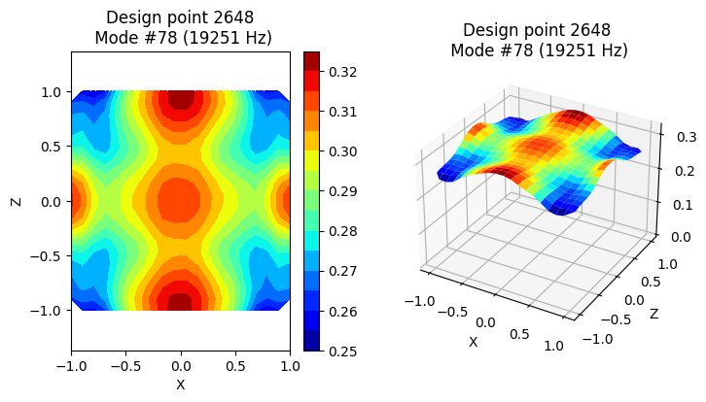
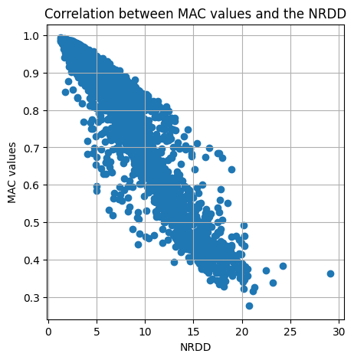
Pre-processing
NRDD = 0 → perfect uniform displacements
NRDD > 10 → poor uniformity
(NRDD = 1.3)
Notes:
A low value of NRDD corresponds to uniform displacements and high values to poor uniformities (the deviations are important)
As an example, you see on the left the DP with the most uniform displacements, NRDD = 1.3
The graph on the right shows the correlation between the MAC values and the metric NRDD
You will probably ask, why I did not take the MAC value as target variable. The reason is that the model perform slightly better with the NRDD than with the MAC value.
So I decided to go on in that direction.
Now we will have a look on the predictions of the longitudinal frequencies in Streamlit

Slide 10
(Streamlit)
Notes:
# Long frequencies:
# (selectbox)
# LGBM base model: y_true y_pred residuals
# LGBM base + tuned model y_true y_pred residuals
# LGBM base + tuned model + filtered model y_true y_pred residuals
# Frequency residuals = f(MAC value)
# Points Best & worst predictions
# (radio) best prediction, worst prediction
# Frequency, MAC values, displacements, frequencies neighbor modes
The filtering of the data set before training improved the accuracy of the predictions

Slide 11
Next steps

Slide 14
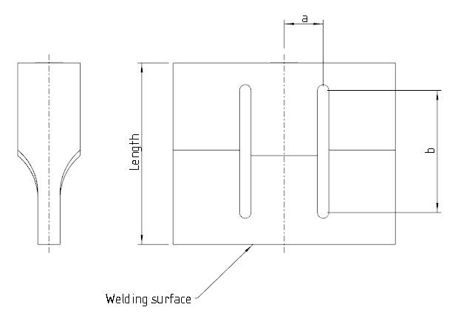
Tuning of the sonotrode geometry
The output surface is mostly defined by the welding part and can not be changed
The rest can be used to optimize the modal properties (tuning)
Typically the length tunes the frequency
Other parameters
a (slot position)
b (slot length)
…

Slide 15
Project
03

Slide 16
Goal of the project: Create a model to predict FEM results
Model can be trained with FEM calculations
Design point can be chosen by the model
One design point ~ 1 minute
Predict FEM results with calculation
Combine prediction with optimization (optional goal)

Slide 17
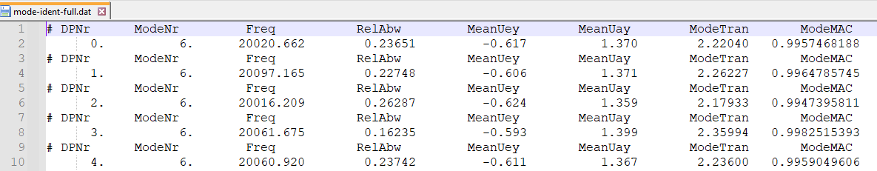
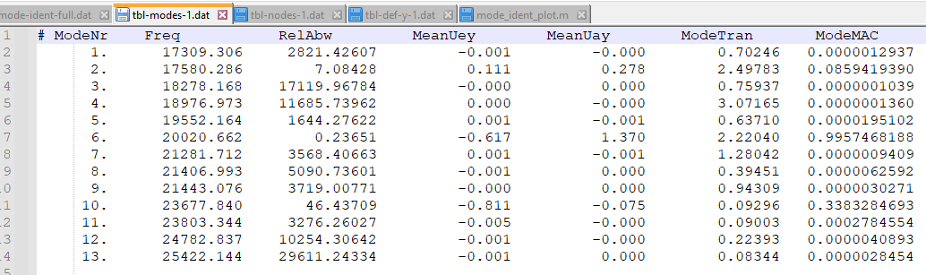
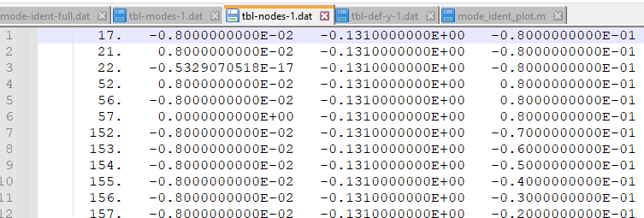
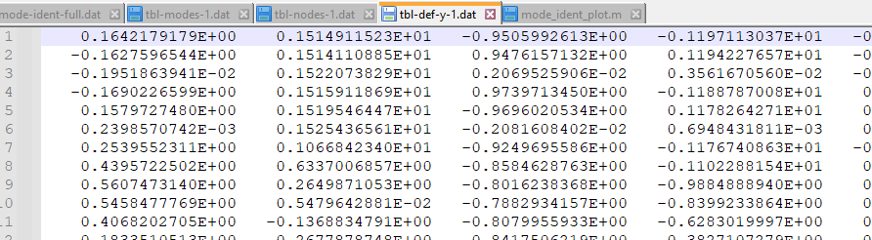
Post-processing script in ANSYS:
Identifies the longitudinal mode and its frequency (Global file for all design points)
Exports result data (One file for each design point):
List of modes and frequencies
List of node coordinates of the welding surface
List of node displacements of the welding surface

Slide 18
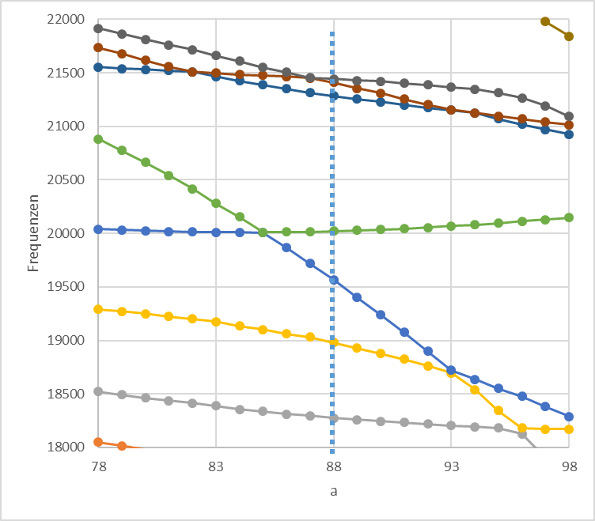
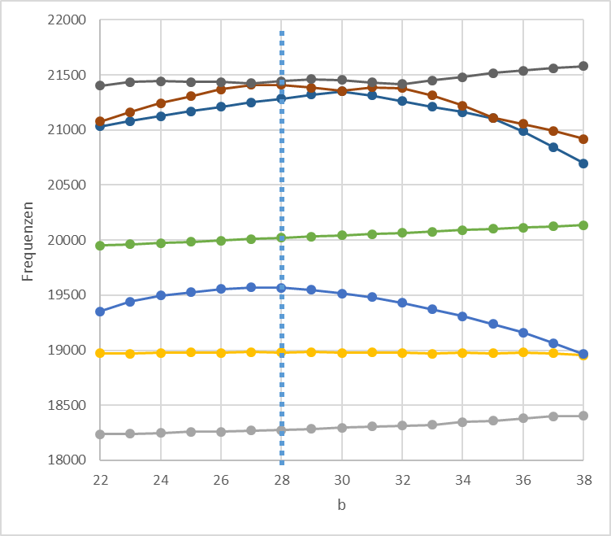
Example: Impact of the slots on modal frequencies
a: slot position
b: slot length

Slide 20

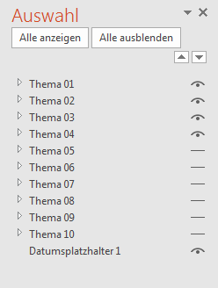
Ein- / Ausblenden von Agenda Themen
Entfernen bzw. hinzufügen weiterer Themen:
Start > Abschnitt „Bearbeiten“ > Markieren > Auswahlbereich
Dann erscheint rechts das Fenster Auswahl. Hier lassen sich einzelne Objekte aus- bzw. einblenden (klicken auf das „Augen-Symbol).
Agenda
01
Thema 01
02
Thema 02
03
Thema 03
04
Thema 04
05
Thema 05
06
Thema 06
07
Thema 07
08
Thema 08
09
Thema 09
10
Thema 10

